Slide 1
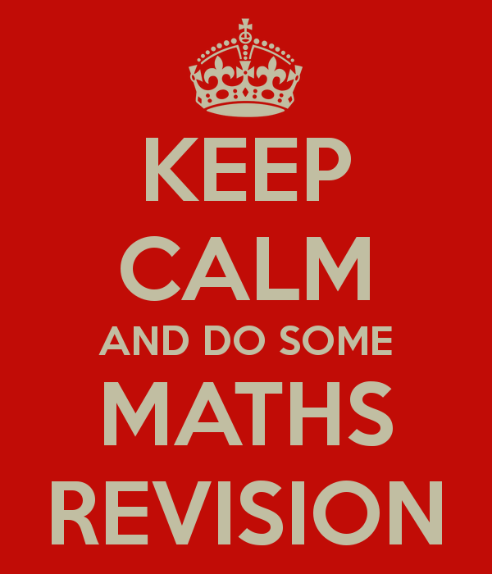

Slide 2
Edexcel GCSE Higher 9-1
Google Classroom
Scheme of Work
Useful websites
Useful purchases
Past Papers
Additional Support
Equipment
Exam Dates

Slide 3
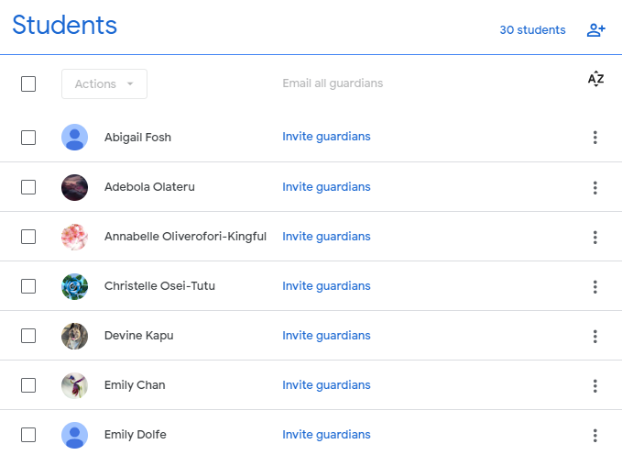
1. Make sure you have been invited to the Google Classroom

Slide 4
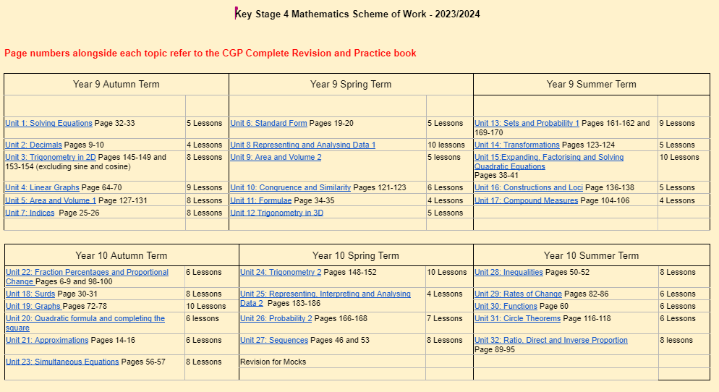
2. The Scheme of Work

Slide 5

3. Useful websites for revision:
Corbett Maths is a free website that has some great revision videos.
The 5-a-day section is a good way to do some maths every single day. There is a choice of difficulty and the answers are available.

Slide 6

3. Useful websites for revision:
Maths Genie is another free website with exam questions and solutions by grade and topic, with links to videos to help with revision.

Slide 7

3. Useful websites for revision:
The school have bought a subscription to this website.
Dr Frost Maths contains exam questions sorted by topic that students can use to check their knowledge.

Slide 8

3. Useful websites for revision:
Another website the school have bought a subscription to.
MyMaths has interactive lessons that students can click through to learn a topic and online homeworks for each lesson that they can use to check understanding.

Slide 9
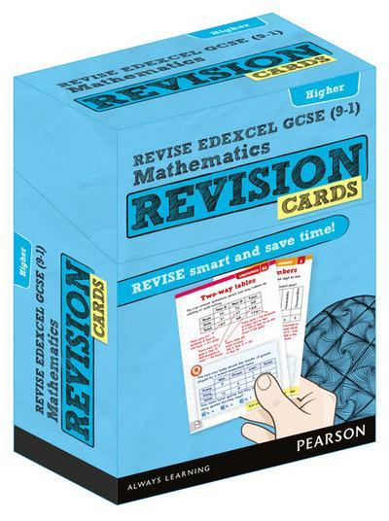
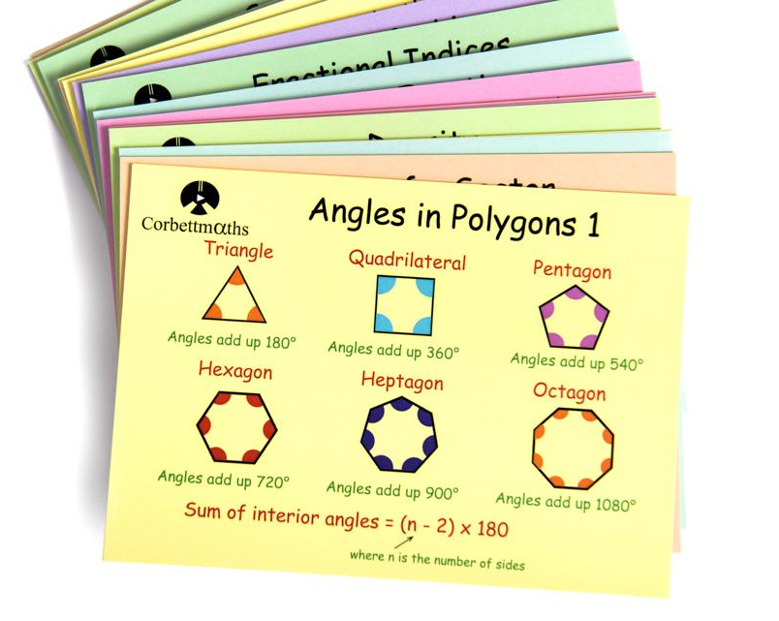
4. Useful purchases for revision:
Corbett Maths Revision Cards £10.99
Contain QR codes on the back which take you to revision videos, exam questions and answers
Edexcel GCSE Maths Revision Cards £8.99
Detailed cards made specifically for Edexcel

Slide 10

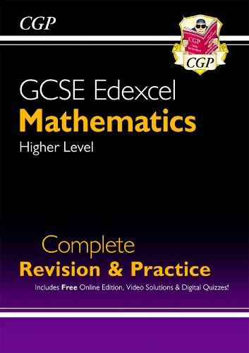
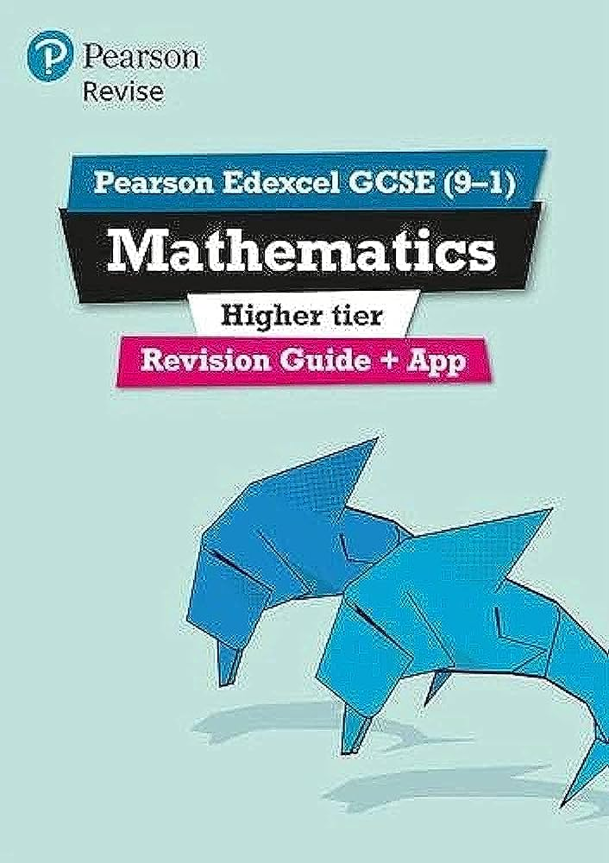
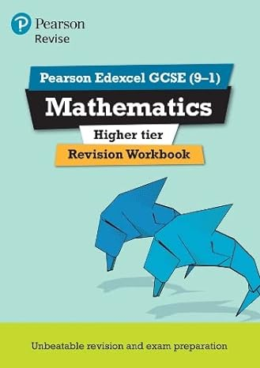

4. Useful purchases for revision:
Complete Revision and Practice £11.99
Revision Guide £5.99
Revision Workbook £4.49

Slide 11
5. Past Papers:
Students will be completing past exam papers in lessons and at home.
To get the most from these students should be:
Completing the papers in full to the best of their ability
Identifying topics they have struggled with and writing them on the front
Using the official mark scheme to assess how well they have done in each paper

Slide 12
Paper | Grade Boundaries
 | 9 | 8 | 7 | 6 | 5 | 4 | 3
June 2017 | 190 | 157 | 124 | 96 | 68 | 41 | 27
Nov 2017 | 189 | 150 | 112 | 85 | 58 | 32 | 19
June 2018 | 202 | 170 | 139 | 109 | 79 | 50 | 35
Nov 2018 | 194 | 159 | 125 | 95 | 66 | 37 | 22
June 2019 | 198 | 167 | 137 | 108 | 80 | 52 | 38
Nov 2020 | 189 | 157 | 126 | 96 | 66 | 37 | 22
Nov 2021 | 187 | 154 | 122 | 93 | 65 | 37 | 23
June 2022 | 194 | 165 | 137 | 104 | 71 | 38 | 21
Nov 2022 | 194 | 165 | 137 | 104 | 71 | 38 | 21
June 2023 | 203 | 174 | 145 | 112 | 79 | 47 | 31

Slide 13
Paper | Grade Boundaries
 | 9 | 8 | 7 | 6 | 5 | 4 | 3
June 2017 Paper 1 | 63 | 52 | 41 | 32 | 23 | 14 | 9 | Mark Scheme | Model Solutions
June 2017 Paper 2 | 63 | 52 | 41 | 31 | 22 | 13 | 8 | Mark Scheme | Model Solutions
June 2017 Paper 3 | 64 | 53 | 42 | 32 | 23 | 14 | 9 | Mark Scheme | Model Solutions
Nov 2017 Paper 1 | 64 | 51 | 38 | 29 | 20 | 11 | 6 | Mark Scheme | Model Solutions
Nov 2017 Paper 2 | 62 | 49 | 37 | 28 | 19 | 11 | 7 | Mark Scheme | Model Solutions
Nov 2017 Paper 3 | 62 | 49 | 37 | 28 | 19 | 10 | 5 | Mark Scheme | Model Solutions
June 2018 Paper 1 | 70 | 59 | 48 | 38 | 28 | 18 | 13 | Mark Scheme | Model Solutions
June 2018 Paper 2 | 68 | 57 | 47 | 37 | 27 | 18 | 13 | Mark Scheme | Model Solutions
June 2018 Paper 3 | 64 | 54 | 44 | 34 | 24 | 14 | 9 | Mark Scheme | Model Solutions
Nov 2018 Paper 1 | 59 | 48 | 38 | 28 | 19 | 10 | 5 | Mark Scheme | Model Solutions
Nov 2018 Paper 2 | 67 | 55 | 43 | 33 | 23 | 13 | 8 | Mark Scheme | Model Solutions
Nov 2018 Paper 3 | 68 | 56 | 44 | 34 | 24 | 14 | 9 | Mark Scheme | Model Solutions
June 2019 Paper 1 | 66 | 56 | 46 | 36 | 27 | 18 | 13 | Mark Scheme | Model Solutions
June 2019 Paper 2 | 71 | 60 | 49 | 39 | 29 | 19 | 14 | Mark Scheme | Model Solutions
June 2019 Paper 3 | 61 | 51 | 42 | 33 | 24 | 15 | 10 | Mark Scheme | Model Solutions
Nov 2019 Paper 1 | 64 | 53 | 43 | 33 | 23 | 13 | 8 | Mark Scheme | Model Solutions
Nov 2019 Paper 2 | 67 | 56 | 45 | 35 | 25 | 15 | 10 | Mark Scheme | Model Solutions
Nov 2019 Paper 3 | 67 | 56 | 45 | 35 | 25 | 15 | 10 | Mark Scheme | Model Solutions
Nov 2020 Paper 1 | 63 | 52 | 42 | 32 | 22 | 13 | 8 | Mark Scheme | Model Solutions
Nov 2020 Paper 2 | 63 | 52 | 42 | 32 | 22 | 12 | 7 | Mark Scheme | Model Solutions
Nov 2020 Paper 3 | 63 | 52 | 42 | 32 | 22 | 12 | 7 | Mark Scheme | Model Solutions
Nov 2021 Paper 1 | 63 | 52 | 41 | 31 | 22 | 13 | 8 | Mark Scheme | Model Solutions
Nov 2021 Paper 2 | 63 | 52 | 41 | 31 | 21 | 12 | 7 | Mark Scheme | Model Solutions
Nov 2021 Paper 3 | 61 | 50 | 40 | 30 | 21 | 12 | 7 | Mark Scheme | Model Solutions
June 2022 Paper 1 | 62 | 53 | 44 | 33 | 22 | 12 | 7 | Mark Scheme | Model Solutions
June 2022 Paper 2 | 67 | 57 | 47 | 35 | 24 | 13 | 7 | Mark Scheme | Model Solutions
June 2022 Paper 3 | 65 | 55 | 46 | 35 | 24 | 13 | 7 | Mark Scheme | Model Solutions
Nov 2022 Paper 1 | 62 | 53 | 44 | 33 | 22 | 12 | 7 | Mark Scheme | Model Solutions
Nov 2022 Paper 2 | 66 | 56 | 47 | 35 | 24 | 23 | 7 | Mark Scheme | Model Solutions
Nov 2022 Paper 3 | 64 | 55 | 46 | 35 | 24 | 13 | 7 | Mark Scheme | Model Solutions
June 2023 Paper 1 | 67 | 57 | 48 | 36 | 25 | 14 | 8 | Mark Scheme | Model Solutions
June 2023 Paper 2 | 68 | 58 | 48 | 37 | 26 | 16 | 11 | Mark Scheme | Model Solutions
June 2023 Paper 3 | 68 | 58 | 49 | 38 | 27 | 17 | 12 | Mark Scheme | Model Solutions

Slide 14
6. Additional Support:
Maths Clinic is on every Monday after school in G10 from 3:10-4pm.
Students bring their own work or topics they need help with and sixth form prefects will support them.

Slide 15
7. Equipment:
All students are required to bring the following pieces of equipment to every maths lesson and will require these for their exams:
Pen
Pencil
Ruler
Rubber
Calculator
Protractor
Pair of compasses

Slide 16
8. Exam Dates:
Maths Paper 1 (Non-calculator)
Thursday 16th May 2024 – 8.30am
Maths Paper 2 (Calculator)
Monday 3rd June 2024 – 8.30am
Maths Paper 3 (Calculator)
Monday 10th June 2024 – 8.30am

