Slide 1

GCSE English Language
GCSE English Literature
Exam Board
Course Overview
Key Dates
Revision Strategies
Resources to use at home

Slide 2
EXAM BOARD
AQA English Language (8700)
AQA English Language (8702)
Any resources you use must be for AQA English and English Literature
The AQA website has some useful past paper questions

Slide 3
ENGLISH LANGUAGE COURSE OVERVIEW
Unit 1: Explorations in Creative Writing and Reading
1 hour 45 minutes
23rd May 2024
External Exam: Worth 50% of the final GCSE English Language grade
Section A: Reading
Four questions on one unseen fiction texts
There will be 1 multiple choice and 3 extended writing answers.
Section B: Writing
One extended creative writing question. This will be marked out of 24 for content and out of 16 for technical accuracy.

Slide 4
ENGLISH LANGUAGE COURSE OVERVIEW
Unit 2: Writer’s Viewpoints and Perspectives
1 hour 45 minutes
6th June 2024
External Exam: Worth 50% of the final GCSE English Language grade
Section A: Reading
Four questions on one unseen non-fiction text
Questions will be 1 multiple choice and 3 extended writing answers.
Section B: Writing
One extended non-fiction writing question. This will be marked out of 24 for content and out of 16 for technical accuracy.

Slide 5

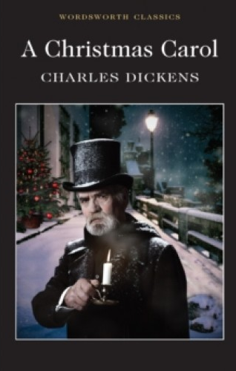
ENGLISH LITERATURE COURSE OVERVIEW
Unit 1: Shakespeare and the 19th Century Novel
1 hour 30 minutes
13th May 2024
External Exam: Worth 40% of the final GCSE English Language grade
Section A: Shakespeare
One question the play studied (Macbeth). Students will be required to write in detail about an extract from the play and the play as a whole.
Section B: 19th Century Novel
On question on A Christmas Carol. Students will be required to write in detail about an extract from the novel and then the novel as a whole.

Slide 6
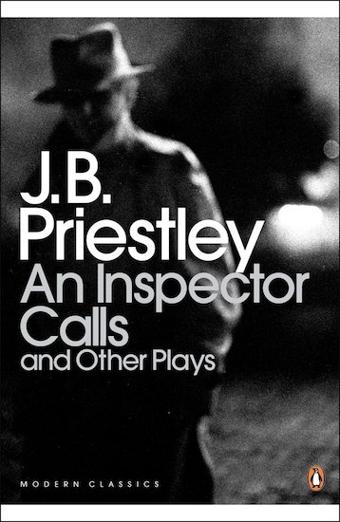

ENGLISH LITERATURE COURSE OVERVIEW
Unit 2: Modern texts and poetry
2 hours 15 minutes
20th May 2024
External Exam: Worth 60% of the final GCSE English Language grade
Section A: Modern Texts
Students will answer one essay question on An Inspector Calls
Section B: Comparative Poetry
Students will answer one question which asks them to compare two poems. One poem will be printed: the other will not.
Section C: Unseen Poetry
Students answer one question on an unseen poem followed by another question asking them to compare this to a second unseen poem.

Slide 7
ENGLISH LITERATURE TEXTS
All English Literature exams are closed text: this means that pupils will not have their copy of their text with them.
Any questions regarding the English and English Literature course?

Slide 8
Mock Exams
Student will sit each of the English Literature and English Language mock exams
English Literature Mock Exams
  English Literature, two papers (excluding Anthology Poetry): January Mocks
English Language Mock Exam
  English Language Paper One: February
It is imperative that students treat their mock exams as if they were their actual exams

Slide 9
Revision
English Language

Slide 10
English Language Reading: Easily Addressed Targets
The exam requires pupils to read and respond to short texts very quickly
Reading a range of texts – not necessarily novels – will help pupils to grow more confident with reading short texts
The exam requires pupils to answer a range of questions with a very limited amount of time
Knowing the specific requirements of each question and how long they have to complete their response is crucial to their success
The difficulty many pupils face with the English Language exam is the time restraints
Practicing reading short texts and planning responses to these texts will help pupils grow more confident when approaching the exam.

Slide 11
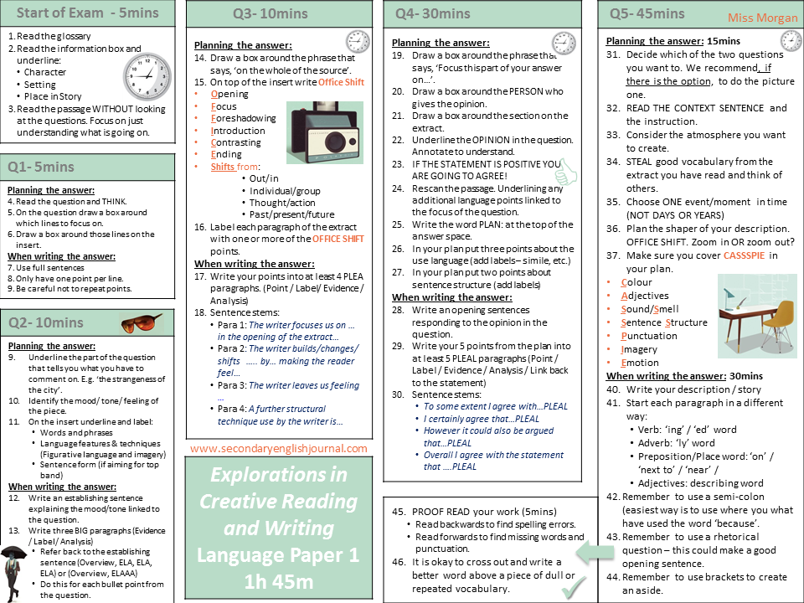

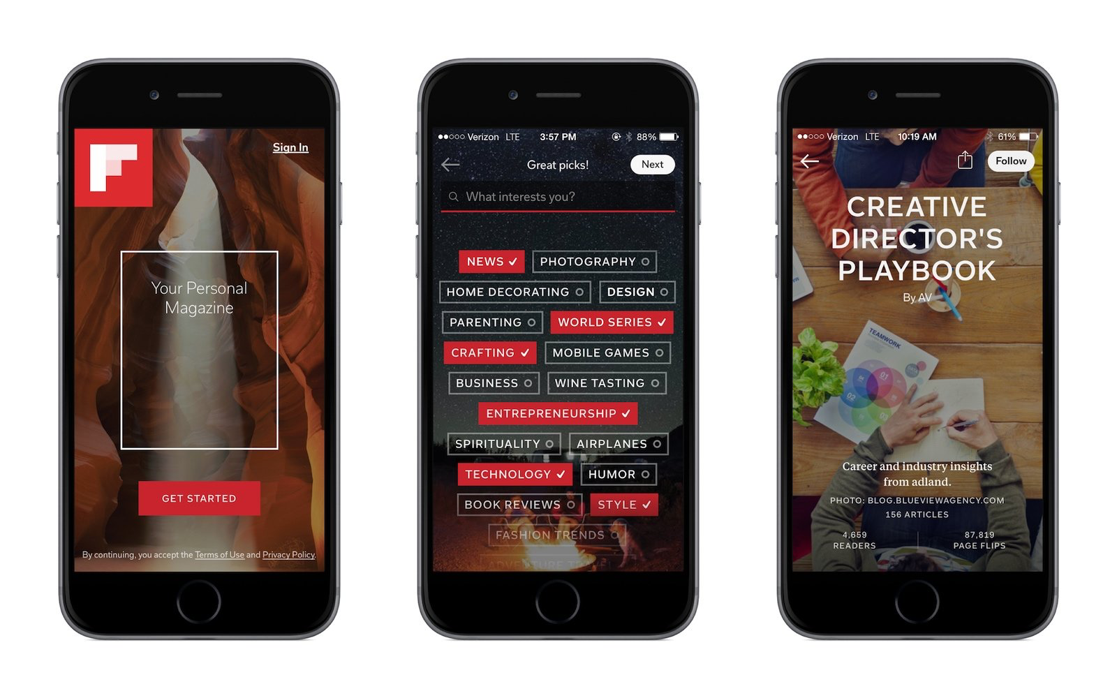

English Language Reading Revision
The internet is a great resource but you need to know what you are looking for:
  Knowledge Organisers
  BGS Google Classroom contains revision resources
  Flipboard, BBC news and The Guardian for free reading material
  BBC Bitesize for AQA English Language
  Mr Bruff AQA English Language videos

Slide 12
English Language Writing
Whereas the reading part of the GCSE English Language exam has its challenges, the writing part of the exam is worth 50% and offers pupils the opportunity gain valuable marks
Students can use resources such as Knowledge Organisers to practice writing in form (newspaper/ letter/ blog) and purpose (argue, persuade/ explain)
Spelling, Punctuation and Grammar (SpaG)
  Students can revise punctuation: particularly colons and semi colons. YouTube is a great resource for this.
  Students can revise frequently misspelt words
Write responses based on past paper questions (see AQA website) or in response to articles they have read
Students should look to imitate things they read: they are demonstrating skill and not necessarily originality

Slide 13
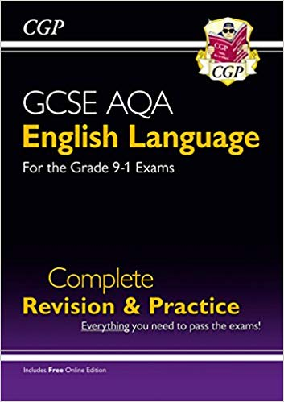
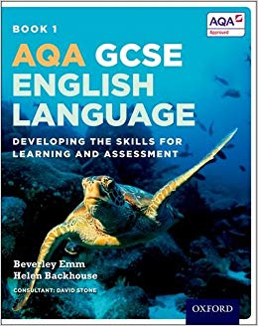
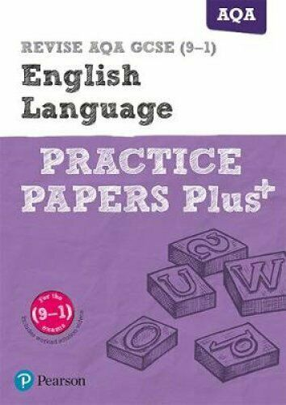
Revision Guides
There are a range of revision guides and even flash cards you can purchase if you wish however ensure you buy them for AQA English Language. Some recommendations are:
  CGP English Language for Grade 9-1 Exams
  AQA GCSE English Language: Student Book: Developing the skills for Learning and Assessment (Oxford)
  Revise AQA GCSE (9-1) English Language Practice Papers (Pearson)

Slide 14
Revision
English Literature

Slide 15
English Literature Targets
The exam requires students to complete the exam WITHOUT copies of the text requiring them to learn quotations
Pupils should re-read the exam texts to re-familiarize themselves with the texts: re-reading the texts is not revision
Return to texts sooner rather than later and then return to them again rather than ‘cram’
Pupils should look to learn quotations rather than try to remember whole sections of texts or even whole poems
Pupils should begin revision by identifying the ten most important quotations for key characters and themes: before long it will become apparent that valuable quotations reappear over and over
Create flash cards or mind-maps of key quotations linked to themes: these can be used for making links across texts/ between poems
Plan responses to a range of questions rather than write whole answers: this helps you to revise whole texts rather than practice limited responses

Slide 16
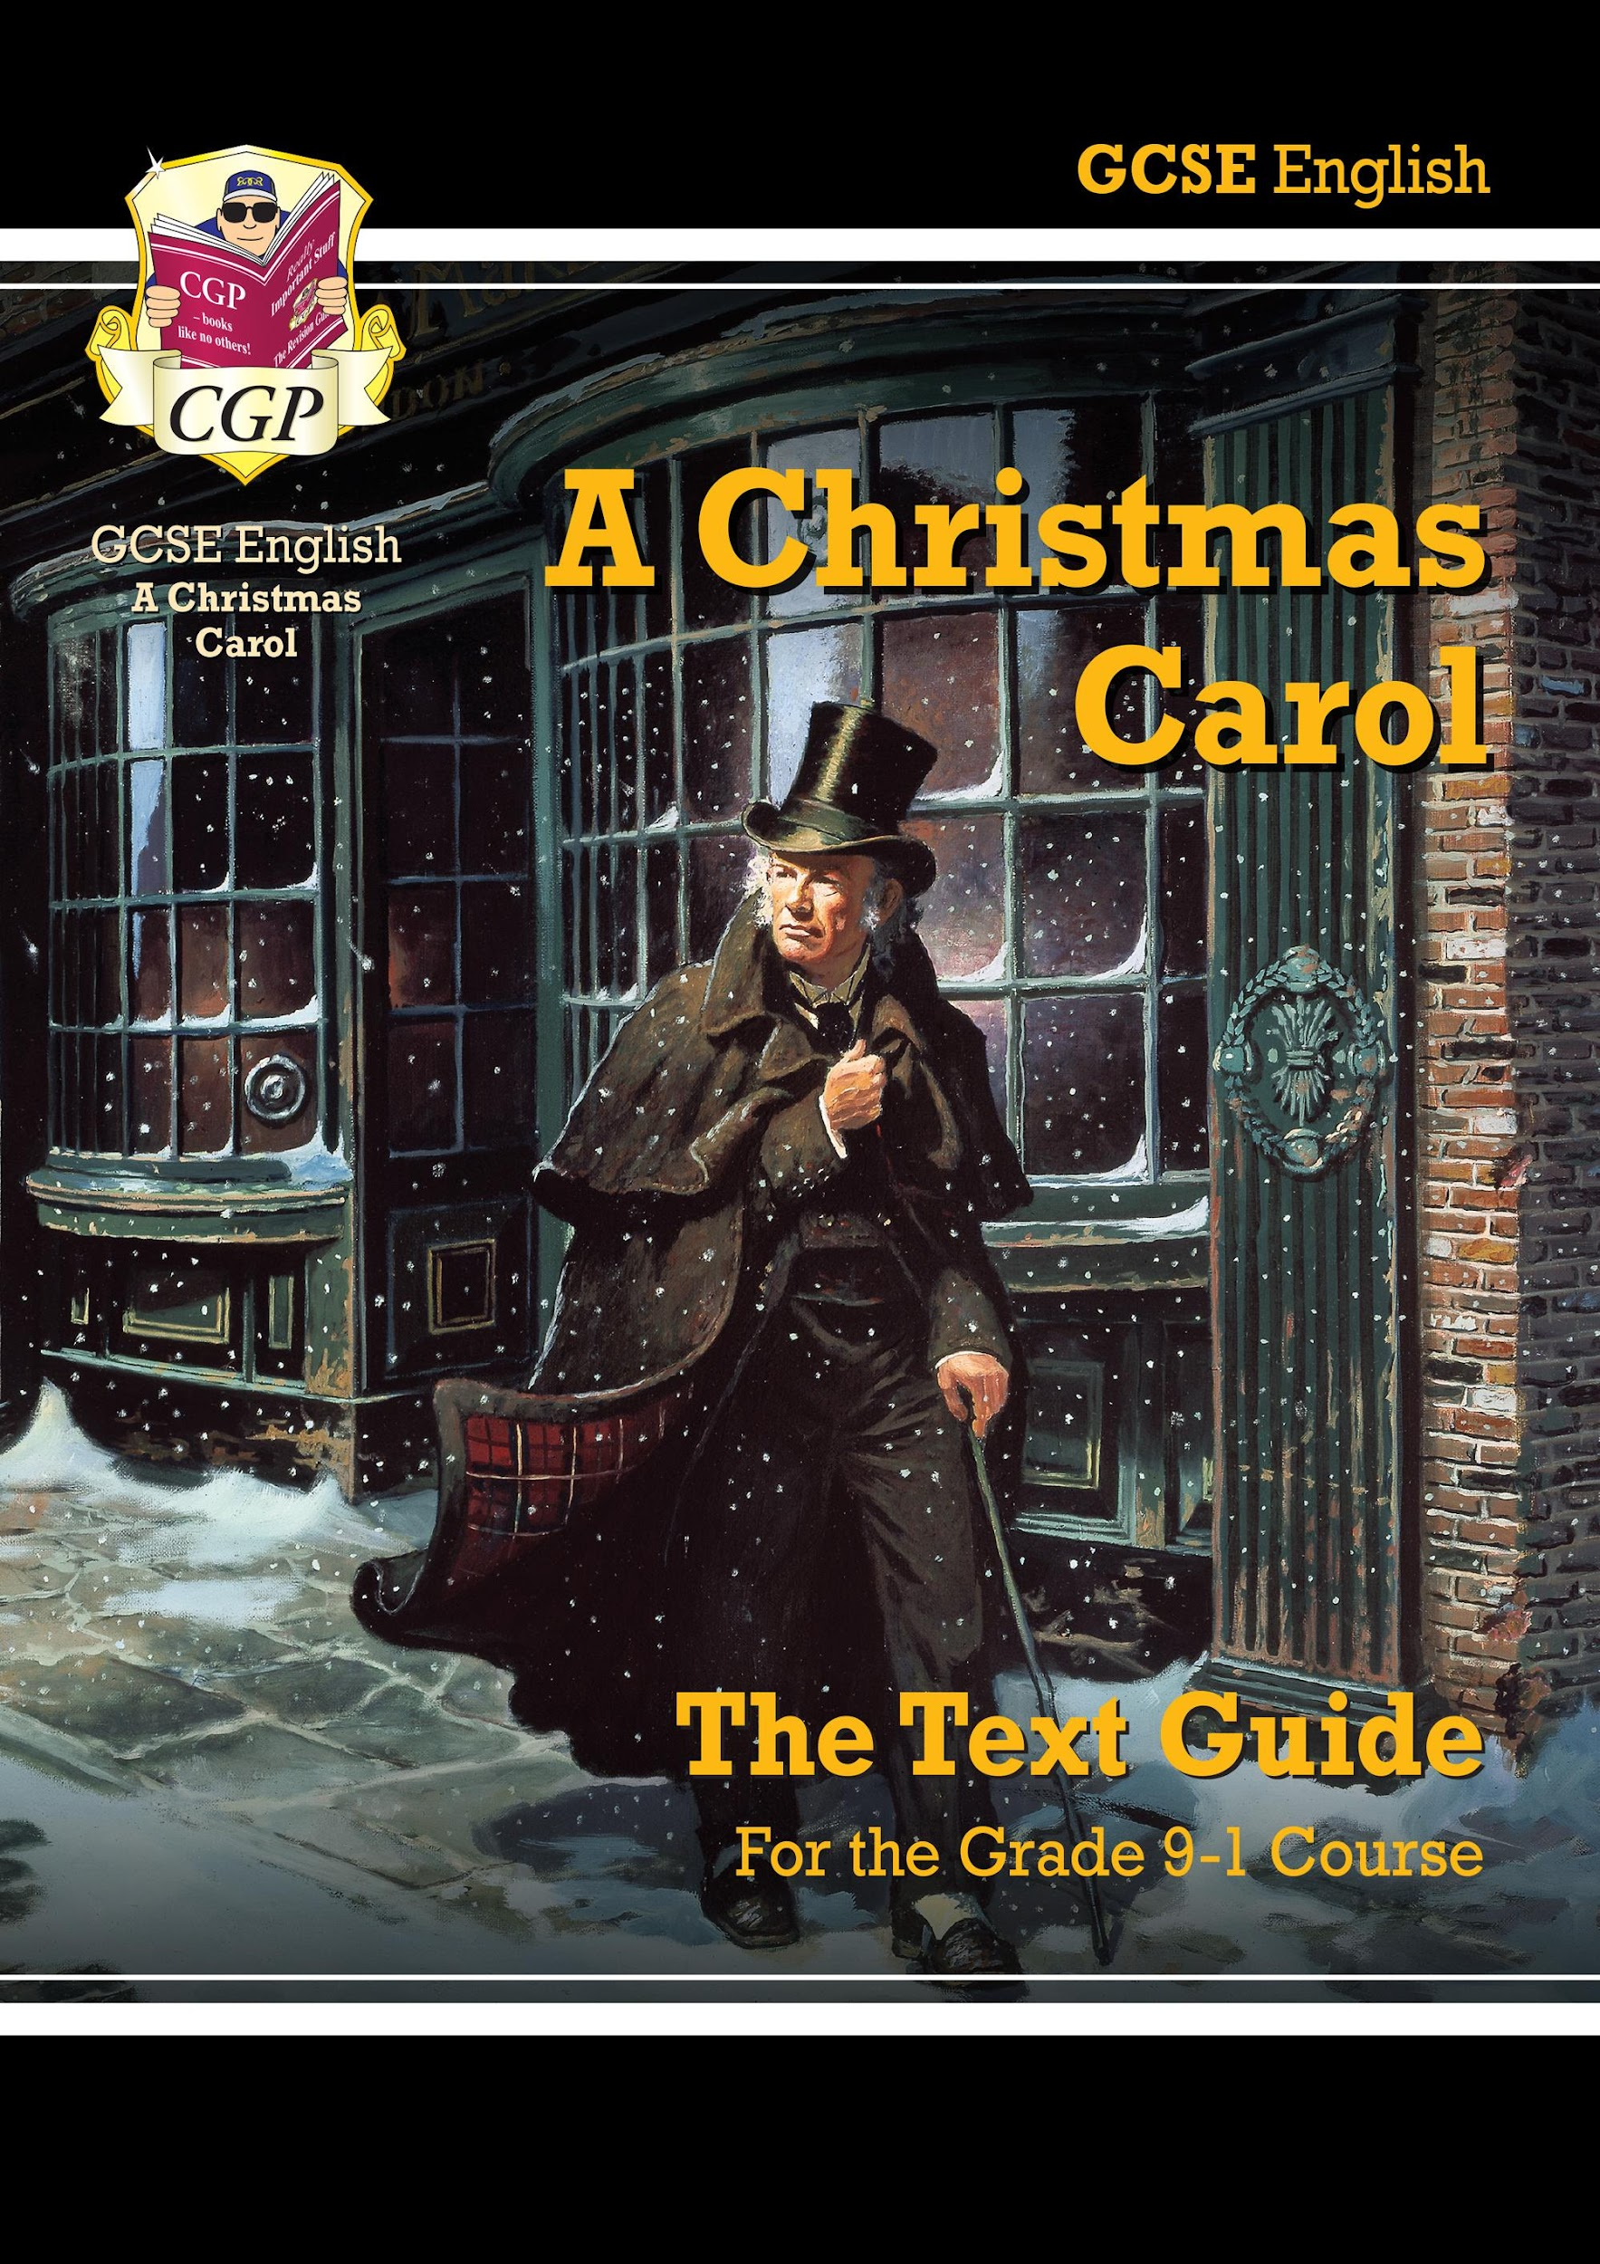
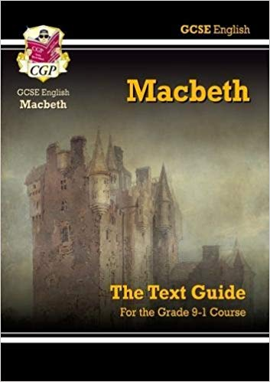
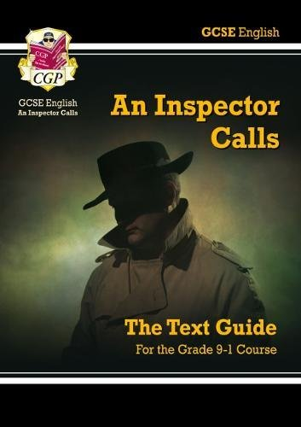
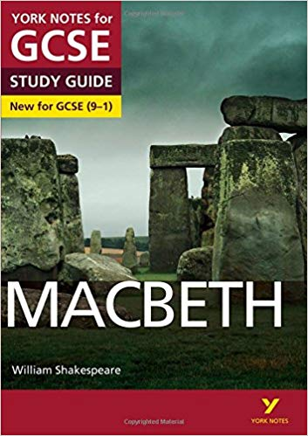
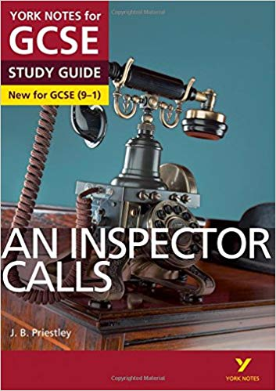
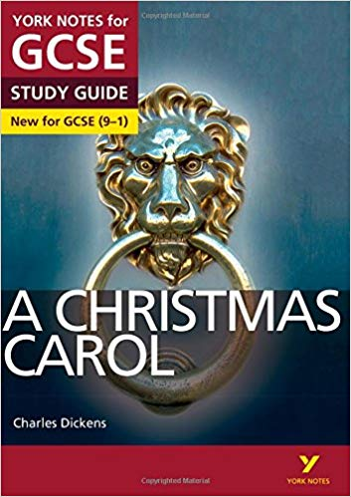
English Literature Revision Guides
There are a wide range of revision guides for the texts studied.
You most likely already have a set of the CGP revision guides.
The department would also recommend York Notes for the texts studied.

Slide 17




English Literature FREE Resources
There are a wide range of English Literature resources available online
  Spark Notes
  Spark Notes: No Fear Shakespeare
  GCSE Bitesize
  LitCharts
  Schmoop
  Universal Teacher
  Mr Bruff (YouTube)

Slide 18
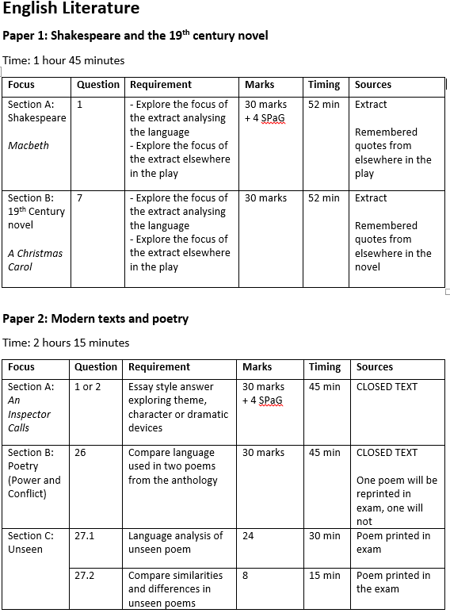
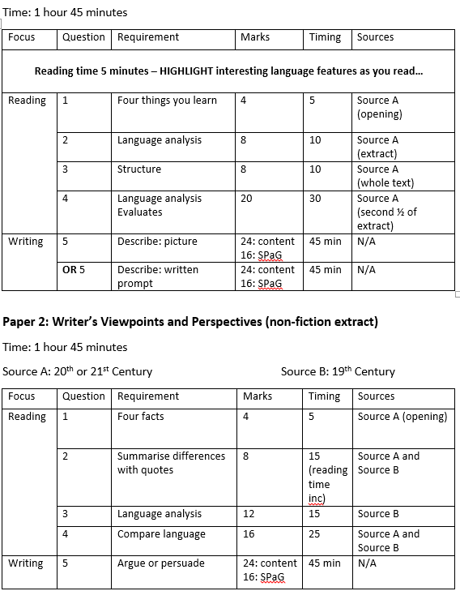
Know the exam

