Slide 1
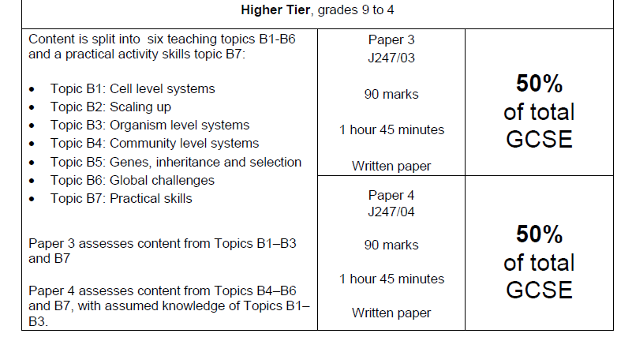
Some background info:
OCR Gateway: Biology:
15% = Practical Skills
10% = Maths Skills
Notes:
For some students, entry at Foundation Tier will be advised. Reduced content and reduced challenge in exam papers.

Slide 2
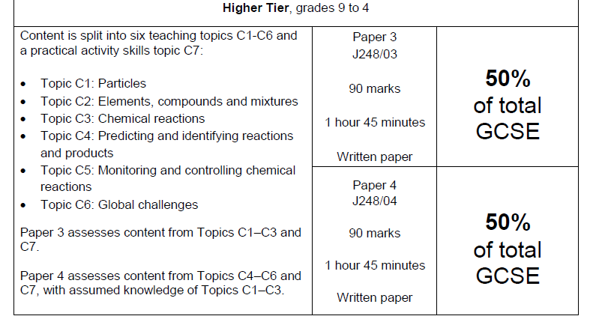
Chemistry:
15% = Practical Skills
20% = Maths Skills
Notes:
For some students, entry at Foundation Tier will be advised. Reduced content and reduced challenge in exam papers.

Slide 3
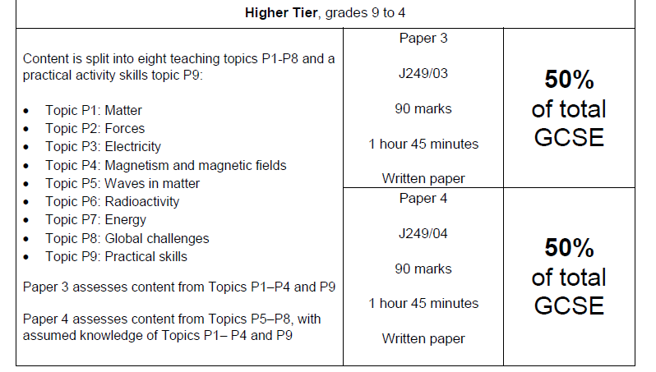
Physics:
15% = Practical Skills
30% = Maths Skills
Notes:
For some students, entry at Foundation Tier will be advised. Reduced content and reduced challenge in exam papers.

Slide 4
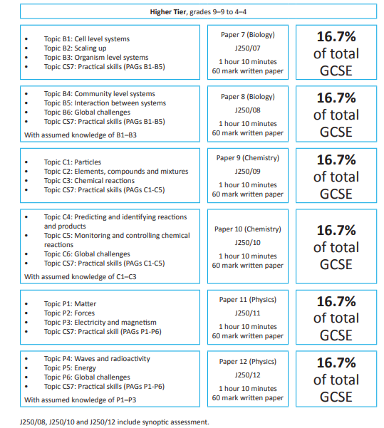
Combined:
15% = Practical Skills
20% = Maths Skills
.This course may
be advised for a
few students
. Reduced content
2 GCSEs

Slide 5

Some key dates:
Jan 24: Biology, Chemistry & Physics mock exams.
[P3 and P4 questions]
Apr 24: Additional Bio, Chem & Phy mock exam [P4]
10/5/24 (am): Biology Paper 3
17/5/24 (am): Chemistry Paper 3
22/5/24 (am): Physics Paper 3
7/6/24 (pm): Biology Paper 4
11/6/24 (am): Chemistry Paper 4
14/6/24 (pm): Physics Paper 4
Notes:
Foundation & Combined papers are timetabled for same dates.

Slide 6

Some advice for them:
Start now.
Prioritise.
Draw up a schedule and stick to it.
‘Little & often’.
‘Active’ is best.
Ask for help.
Prepare as well as possible for mock exam.

Slide 7



Some revision resources:
DIY:
- ‘flashcards’, etc.
CGP revision guides.
https://www.cgpbooks.co.uk/Parent/books_gcse_science.books_gcse_biology_revision#OCR
CGP ‘Test & Learn’ app for phone.
Specimen exam papers
& mark schemes on OCR website.
Seneca
Cognito
BBC Bitesize website.
Notes:
https://www.cgpbooks.co.uk/Parent/books_gcse_science.books_gcse_biology_revision#OCR

Slide 8

Additional support:
Science Clinic:
Every Thursday (3.15 – 4.00)(Autumn term onwards).
Personalised support from Science prefects.
Supervised by Science staff.

Slide 9

What you can do to help:
Ensure they have revision resources.
Ensure they attend clinic sessions.
Gentle reminders! (& encouragement!)
Be a ‘Quiz master’.
Speak to teacher(s) about any concerns you have.

