Slide 1

Year 11 Support and Succeed
Parent Information Evening
Developing compassionate leaders

Slide 2
Presentations this evening
Introduction
Mrs Howard - Director of Learning Key Stages 3 & 4
Mrs Ellis - Deputy Head
Ms Orchard - Director of Studies Year 11
Mrs Moore
Miss Mani
Miss Giglioni
Ms Adeaga
Science
Head of Science
Blue programme session 1
Remain in the hall
Maths
Head of Key Stage 4
Blue programme session 1
Remain in the hall
MFL
Head of Key Stage 4
Yellow programme session 1
K10
English
Head of Key Stage 4
Yellow programme session 1
K10

Slide 3
Working together
35 hours per week in school
168 hours in a week
20 teaching weeks remaining
Most GCSE grades from science, maths, MFL and english
Having the tools and understanding to best support at home
Developing compassionate leaders

Slide 4
Questions
A feedback form link will be emailed to you
Please ask any questions that you may have on that form and they will be directed to the relevant teacher
Developing compassionate leaders

Slide 5
Key dates
Progress review evening 21st November
Exam information booklets released this week
Mock exams, week commencing 8th January
Developing compassionate leaders

Slide 6
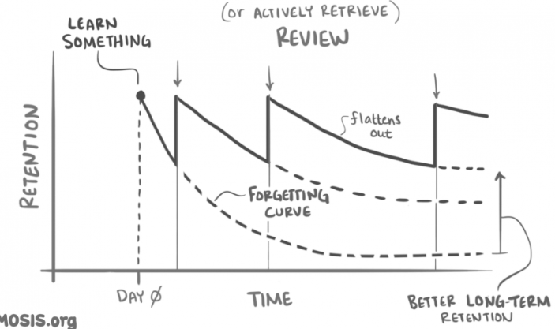
Effective Revision

Slide 7
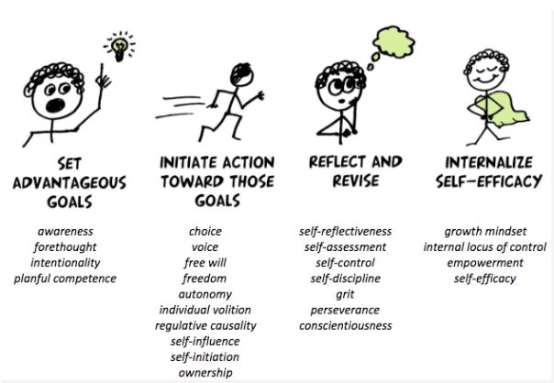
Effective Revision

Slide 8
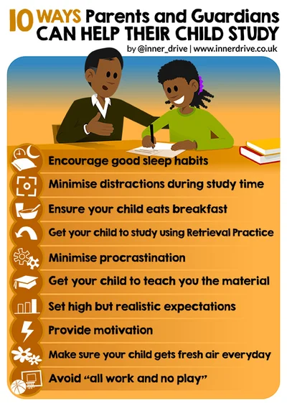
Effective Revision
Spaced out
Active restructuring
Application
Metacognitive

Slide 9
Effective Revision
Spaced out
Active restructuring
Application
Metacognitive
The mere presence of a phone can cause a 20% decline in performance – even if students don’t use it.
A review of 37 studies found that high parental expectations significantly contribute to improving student grades. These expectations instill belief and motivate students to work harder. However, it's crucial that these expectations are paired with supportive actions that enable the child to develop resilience and overcome setbacks.

Slide 10
Presentations this evening
Introduction
Mrs Howard - Director of Learning Key Stages 3 & 4
Mrs Ellis - Deputy Head
Ms Orchard - Director of Studies Year 11
Mrs Moore
Miss Mani
Miss Giglioni
Ms Adeaga
Science
Head of Science
Blue programme session 1
Remain in the hall
Maths
Head of Key Stage 4
Blue programme session 1
Remain in the hall
MFL
Head of Key Stage 4
Yellow programme session 1
K10
English
Head of Key Stage 4
Yellow programme session 1
K10

